Slide 1
Self monitoring

Slide 2
DR Amina Muazzam

Slide 3
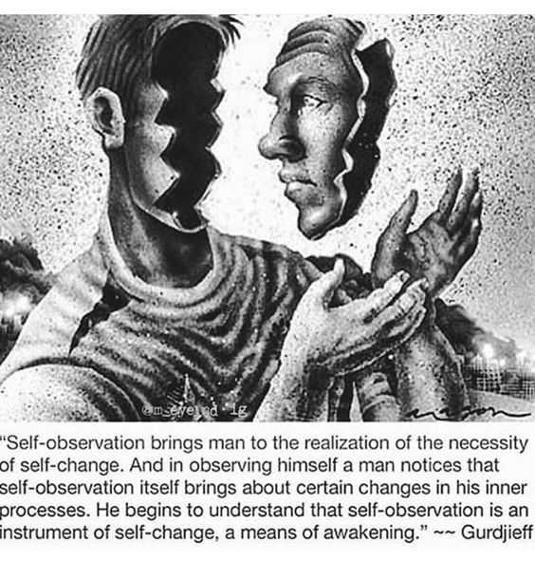
introspection
Introspection is the examination of one's own conscious thoughts and feelings.
Self observation
Observation of one's own countenance or appearance. Examination of one's own thoughts or emotions.
Self monitoring
Self-monitoring is the ability to both observe and evaluate one's behavior.

Slide 4
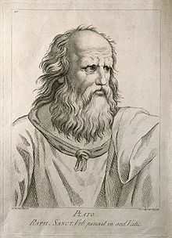
History
Philosophy and Plato
Introspection has been a subject of philosophical discussion for thousands of years. The philosopher Plato asked, "…why should we not calmly and patiently review our own thoughts, and thoroughly examine and see what these appearances in us really are?"

Slide 5
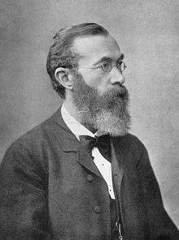
Wilhelm Wundt
It has often been claimed that Wilhelm Wundt, the father of modern psychology, was the first to adopt introspection to experimental psychology. Wundt believed the method of introspection was the ability to observe an experience, not just the logical reflection or speculations which some others interpreted his meaning to be.
Notes:
William james was one who reserched on it first. Wilhelm Wundt was more representative of the spirit of the new psychology. He established what many people consider to be the ﬁ rst laboratory for experimental psychology, with the date usually being given as 1879. He also wrote its ﬁ rst textbook and published its ﬁ rst journal. Perhaps most important of all, he trained around 150 graduate students from diﬀ erent parts of the world, many of whom went back to their own countries and established laboratories for experimental psychology along similar lines.

Slide 6
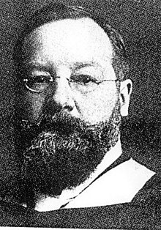
Edward Titchener
Edward Titchener was an early pioneer in experimental psychology and student of Wilhelm Wundt. Titchener was a key figure in bringing Wundt's ideas to America. However, Titchener misrepresented some of Wundt's ideas to the American psychological establishment, especially in his account of introspection which, Titchener taught, only served a purpose in the qualitative analysis of consciousness into its various parts while Wundt saw it as a means to quantitatively measure the whole of conscious experience. He used the term self observation.

Slide 7
Types of introspection
Self-reflection is a positive form of introspection, from which people attribute meaning and significance to their thoughts and actions, accept and learn from their mistakes, and increase their self-awareness
Self-rumination is the opposite: it is a negative form of introspection, from which a person obsesses over their shortcomings, doubting themselves and their self-worth.

Slide 8
Types Self observation
Mindfulness is a special type of self-observation; that is attention to the experience of the self in the present moment without cognitive elaboration
self-analysis is broader in its scope than mindfulness in that it encompasses thinking about the self that is not tied to the present Moment.
Insight is defined as new understandings about self, others, or the world. Self-insight is insight specifically about the self, the product of successful self-observation

Slide 9
Self monitoring
the ability to notice our own actions, curiosity to examine the effects of those actions, and willingness to use those observations to improve behavior and thinking in the future
Self-monitoring allows for the early recognition of cognitive biases, technical errors, and emotional reactions and may facilitate self-correction and development of relationships.
Cognitive neuroscience has begun to explore the brain functions associated with self-monitoring, and the structural and functional changes that occur during mental training to improve attentiveness, curiosity, and presence.

Slide 10
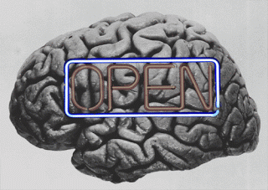
It involves cultivating habits of mind such as experiencing information as novel, thinking of "facts" as conditional, seeing situations from multiple perspectives, suspending categorization and judgment, and engaging in self-questioning.

Slide 11
Types of self monitoring
Those who monitor themselves in a highly meticulous manner are considered high self-monitors. They tend to project a particular image of themselves in order to fit in or impress others. High self-monitors readily adjust their behavior to the situation at hand.
Low self-monitors, on the other hand, tend to regulate themselves according to their own internal beliefs and are typically less concerned with social context. They tend to project an image true to their inner selves rather than put on a facade. Low self-monitors tend to care little about adjusting their behavior to the social situation and keep the same beliefs and attitudes regardless of others’ opinions.

Slide 12
Self monitoring scale
The self monitoring scale measures the extent to which an individual has the will and ability to modify how they are perceived by others. This test was developed by Mark Snyder (1974).
The test consists of twenty five items that could possibly apply to yourself that you must rate as true or false. Each item should be responded to quickly without over-thinking. The test should take no more than two minutes.

Slide 13
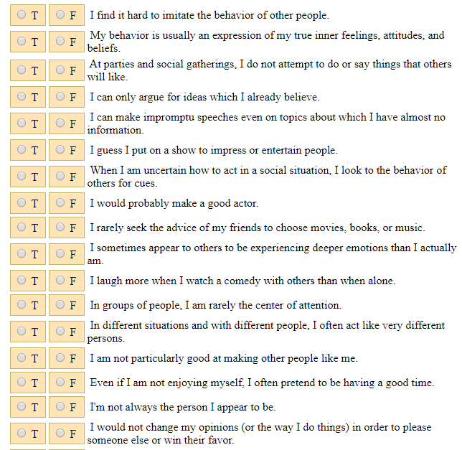

Slide 14
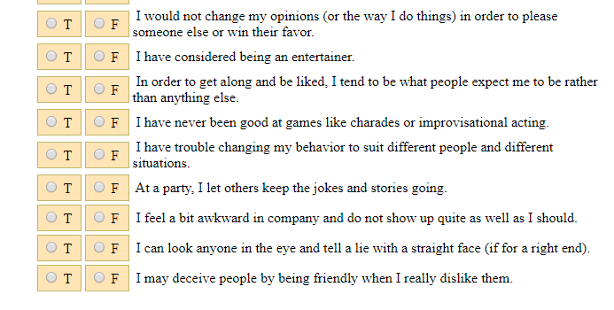

Slide 15
Self monitoring in health psychology
Self-monitoring in the context of chronic illness has been defined as the patient undertaking one or more of the following activities
(i) self-measurement of vital signs, symptoms, behaviour or psychological well-being
(ii) self-interpretation of this data
(iii) self-adjustment of medication, treatment, lifestyle or help-seeking behaviour

Slide 16
Implications
Clinical use
The clinical benefits of self-monitoring in chronic illness include reductions in HbA1c , improvements in blood pressure , and reductions in mortality and adverse events . As a result, self-monitoring is part of recommended practice in a number of chronic conditions.

Slide 17
Self monitoring devices and apps
an increasing number of people are using personal gadgets to monitor their own fitness and health indicators, plus how they use their time, in order to improve wellbeing and personal efficiency. individuals use intelligent tools like wearable sensors and mobile apps to collect, process and display a wealth of personal data to help them monitor and manage all aspects of their personal health.
Self monitoring and BP
Evidence from clinical trials has shown us that patients with hypertension who self-monitor their blood pressure (BP) tend to have lower BP than those patients who don’t. It is likely that self-monitoring supports changes in behaviour in the patients, their doctors or both.

Slide 18
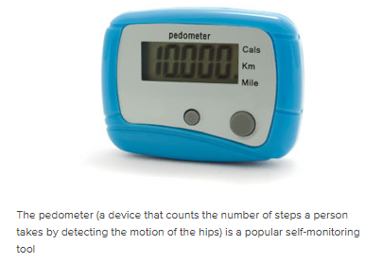
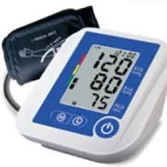
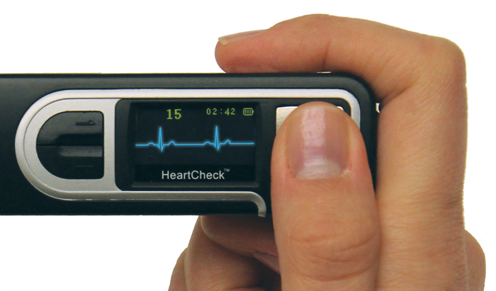
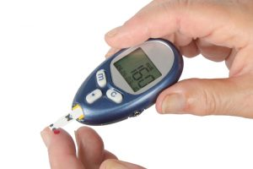
Self monitoring devices

Slide 19
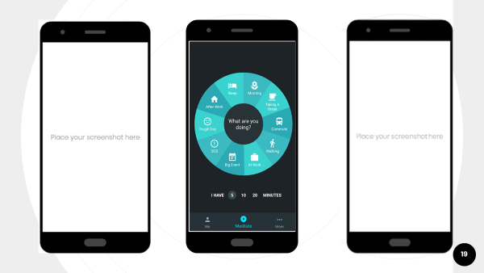
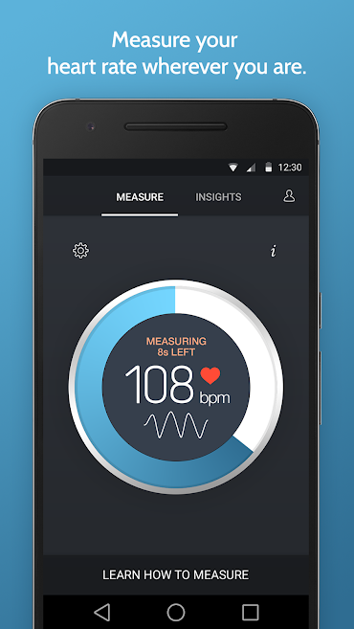
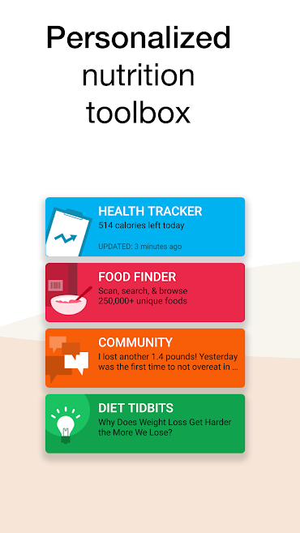
Google fit
Instant heart rate
fooducate

Slide 20
Interpersonal Relationships
The social worlds of high and low self-monitors are characterized distinctly. The social groups of high self-monitors tend to differ depending on the context; they have different friends in different situations. Conversely, low self-monitors tend to have a stable group of friends who are similar to them in a global way.
Application to Consumer Behavior
The study of consumer behavior is one area to which researchers have applied knowledge of self-monitoring. In line with their propensity toward managing outward appearances, high self-monitors tend to prefer advertisements that appeal to a particular image and will select products that will help them convey an image in a certain situation. Low self-monitors prefer advertisements that focus on a product’s quality and are less swayed by attractive packaging than are high self-monitors.

Slide 21
Self monitoring as a counseling technique
Self-Monitoring involves learning to pay careful and systematic attention to your problem behaviors and habits, and to the stimuli that trigger them into action.
There are two types of self-monitoring we can distinguish: qualitative monitoring, and quantitative monitoring.
Qualitative monitoring involves paying attention to the quality of things that are happening (how they make you feel, what they look like, etc.).
Quantitative monitoring, on the other hand, involves counting things.
Though both kinds of monitoring are important, self-monitoring works best when you approach it in a primarily quantified way.

Slide 22
Self monitoring as a counseling technique
Steps of self monitoring technique
deciding what behaviors and habits you will monitor
figuring out a reasonable way to count or measure the occurrence of each behavior or habit
and then actually counting the occurrence of each and every behavior using your measurement system.
You need to have a system in place to self-monitor well. Your system should describe what you will monitor (behaviors, triggers), how often you will monitor, and how you will record your observations

Slide 23
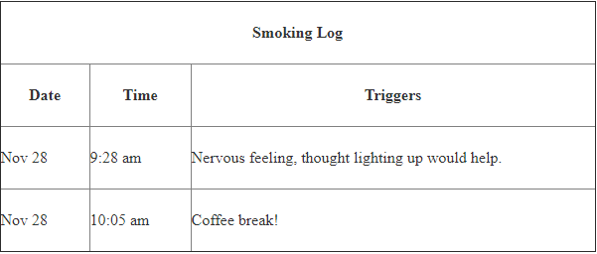

Slide 24
Self monitoring Disadvantages
Some participants showed concern that self-monitoring could lead to the development of health disorders such as eating disorders and depression, particularly where calorie counting is involved as a method. The strategic design of self-monitoring tools needs to consider such risks and the psychological impact of this method to encourage healthy behaviours rather that potentially catalyze unhealthy extremes.
Personal bias is also one of the greatest weakness of self monitoring.

Slide 25
THANKU

